Slide 1


Performing Data analytics

Slide 2


Today’s Agenda
Project Recap
To provide a high-level overview of the business problem we're tackling and the precise requirements, we will provide a summary of the entire project.
Problem
We will get into the particular issue that the Data Analytics team has been concentrating on and provide some context for why this is such a significant issue.
The Analytics Team
I'll start by outlining the issue and then discuss the team that is in charge of handling this assignment on our end.
Process
After that, I'll go into the general steps we took to do this assignment so you can fully understand how we approach tasks of this nature.
Insights & Summary
Lastly, I will review all significant findings and offer them as a collection of understandings and illustrations from our data
Notes:
Need changes

Slide 3

“Social Fuzz” is rapidly growing company in Social media & content creation field space that needs to quickly adjust to its global reach.
Accenture has started working on the following activities during a three-month POC :
An examination of Social Buzz's use of big data
Strategies for a prosperous initial public offering (IPO)
An examination to determine the top 5 content categories on Social Buzz
Project Recap

Slide 4

Problem
Over the past 5 years, Social Buzz has reached over 500 million active users each month. They have scaled quicker than anticipated and need the help of an advisory firm to oversee their scaling process effectively.
Due to their rapid growth and digital nature of their core product, the amount of data that they create, collect and must analyze is huge.
Every day over 100,000 pieces of content are posted. All of this data is highly unstructured and requires extremely sophisticated and expensive technology to manage and maintain.
Out of the 250 people working at Social Buzz, 200 of them are technical staff working on maintaining this highly complex technology.

Slide 5



Senior principal
Marcus Rompton
The Analytics team
Data Scientist
Michalle Grove
Data Analyst
Vidhya Bharathi Raj

Slide 6
Process
1
Data profiling
2
Data Cleaning
3
Data Modeling
4
Data Analyzing
5
Data Visualizing

Slide 7

Insights
Category With Highest Score - Animals
Unique Categories
Month with
Most Posts
16
75K
MAY

Slide 8
Top 5 Categories

Slide 9
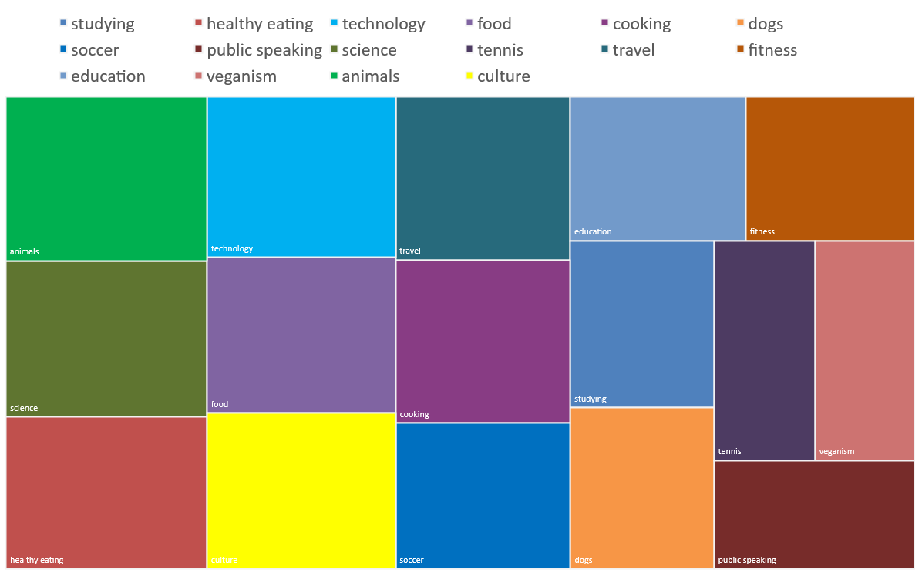
All Categories – Reactions Score

Slide 10

ANALYSIS
Animals and science are two of the most popular content categories, this shows that people enjoy “real-life” and “factual” content the most. So I would recommend that you keep creating more contents relating to these two categories.
INSIGHT
Summary
Food is a common theme with the top 5 categories with “Healthy Eating” ranking as one of the highest. This may give an indication to the audience within your user base. You could use this insight to create a campaign and work with healthy eating brands to boost user engagement.
NEXT STEPS
It should come as no surprise that technological content is among the top categories given the advancement of technology. It indicates that users like your technological material. Working with some of the biggest digital companies in the world is something I would suggest doing because it would undoubtedly increase user engagement.

Slide 11
Thank you!
ANY QUESTIONS?

